Slide 1
Cornerstone City Church Peninsula Plus Community Hoo Are Ya 04-09-2022

Slide 2
You are Good
CCLI Song # 3383788
Israel Houghton
© 2001 Integrity's Praise! Music (Admin. by Integrity Music Ltd)
Sound Of The New Breed (Admin. by Integrity Music Ltd)
For use solely with the SongSelect® Terms of Use. All rights reserved. www.ccli.com
CCLI Licence No. 33265

Slide 3
1/3
Lord You are good
And Your mercy endureth forever
Lord You are good
And Your mercy endureth forever
People from every nation and tongue
From generation to generation

Slide 4
2/3
We worship You
Hallelujah hallelujah
We worship You for who You are
We worship You
Hallelujah hallelujah
We worship You for who You are
For You are good

Slide 5
3/3
You are good all the time
All the time You are good
You are good all the time
All the time You are good

Slide 6
Revelation Song
CCLI Song # 4447960
Jennie Lee Riddle
© 2004 Gateway Create Publishing (Admin. by Integrity Music Ltd)
For use solely with the SongSelect® Terms of Use. All rights reserved. www.ccli.com
CCLI Licence No. 33265

Slide 7
1/4
Worthy is the Lamb Who was slain
Holy holy is He
Sing a new song to Him Who sits on
Heaven's mercy seat

Slide 8
2/4
Holy, Holy, Holy
Is the Lord God Almighty
Who was and is and is to come
With all creation I sing
Praise to the King of kings
You are my ev'rything
And I will adore You

Slide 9
3/4
Clothed in rainbows of living colour
Flashes of lightning rolls of thunder
Blessing and honour strength and glory
And power be to You the only wise King

Slide 10
4/4
Filled with wonder awestruck wonder
At the mention of Your name
Jesus Your name is power breath and living water
Such a marv'lous mystery

Slide 11
King of Kings
CCLI Song # 7127647
Brooke Ligertwood | Jason Ingram | Scott Ligertwood
© 2019 Fellow Ships Music (Admin. by Essential Music Publishing LLC)
So Essential Tunes (Admin. by Essential Music Publishing LLC)
Hillsong Music Publishing Australia (Admin. by Hillsong Music Publishing UK)
For use solely with the SongSelect® Terms of Use. All rights reserved. www.ccli.com
CCLI Licence No. 33265

Slide 12
1/9
In the darkness we were waiting
Without hope without light
Till from Heaven You came running
There was mercy in Your eyes

Slide 13
2/9
To fulfil the law and prophets
To a virgin came the Word
From a throne of endless glory
To a cradle in the dirt

Slide 14
3/9
Praise the Father
Praise the Son
Praise the Spirit three in one
God of Glory
Majesty
Praise forever to the King of kings

Slide 15
4/9
To reveal the kingdom coming
And to reconcile the lost
To redeem the whole creation
You did not despise the cros

Slide 16
5/9
For even in Your suffering
You saw to the other side
Knowing this was our salvation
Jesus for our sake You died

Slide 17
6/9
And the morning that You rose
All of heaven held its breath
Till that stone was moved for good
For the Lamb had conquered death

Slide 18
7/9
And the dead rose from their tombs
And the angels stood in awe
For the souls of all who'd come
To the Father are restored

Slide 19
8/9
And the Church of Christ was born
Then the Spirit lit the flame
Now this Gospel truth of old
Shall not kneel shall not faint

Slide 20
9/9
By His blood and in His Name
In His freedom I am free
For the love of Jesus Christ
Who has resurrected me

Slide 21
Jesus, You Are Performed by Sharene Ricketts
Written by Charlene Jones & Neal Glanville
© 2014 King’s Church London

Slide 22
1/6
You are the voice that speaks light into darkness
You are the One who exchanges our hearts
You are the love where I thought I was loveless
You are, Jesus You are

Slide 23
2/6
You are the calm in the midst of the storm
You are the hope to a world without hope
You are the joy, You’re my comfort, my all
You are, Jesus You are

Slide 24
3/6
Jesus, name above every name
Jesus, You are the One who saves
Jesus, Son of God, Son of man
You are the One Jesus,
You are the One

Slide 25
4/6
You are the healer, the source of my strength
You offer forgiveness, take me as I am
You are a King, yet so humbly You came
You are, Jesus You are

Slide 26
5/6
You are a master, yet You came to serve
Offered Your life, showed there’s no greater love
All that I am and all that I have is Yours
You are Lord

Slide 27
6/6
I’ll stand in awe of You,
My heart poured out to You
All of my doubts, all of my fears
I lay them all down, Lord at Your feet
All of my heart, all of my hopes,
I’ll give to You

Slide 28
There Is A Redeemer
CCLI Song # 11483
Melody Green
© 1982 Universal Music - Brentwood Benson Publishing (Admin. by Brentwood-Benson Music Publishing, Inc.)
Birdwing Music (Admin. by Capitol CMG Publishing)
Ears To Hear (Admin. by Capitol CMG Publishing)
For use solely with the SongSelect® Terms of Use. All rights reserved. www.ccli.com
CCLI Licence No. 33265

Slide 29
1/3
There is a Redeemer Jesus God's own Son
Precious Lamb of God Messiah Holy One Thank You O my Father
For giving us Your Son
And leaving Your Spirit
Till the work on earth is done

Slide 30
2/3
Jesus my Redeemer name above all names
Precious Lamb of God Messiah
O for sinners slain Thank You O my Father
For giving us Your Son
And leaving Your Spirit
Till the work on earth is done

Slide 31
3/3
When I stand in glory I will see His face
There I'll serve my King forever
In that holy place Thank You O my Father
For giving us Your Son
And leaving Your Spirit
Till the work on earth is done

Slide 33


Slide 34
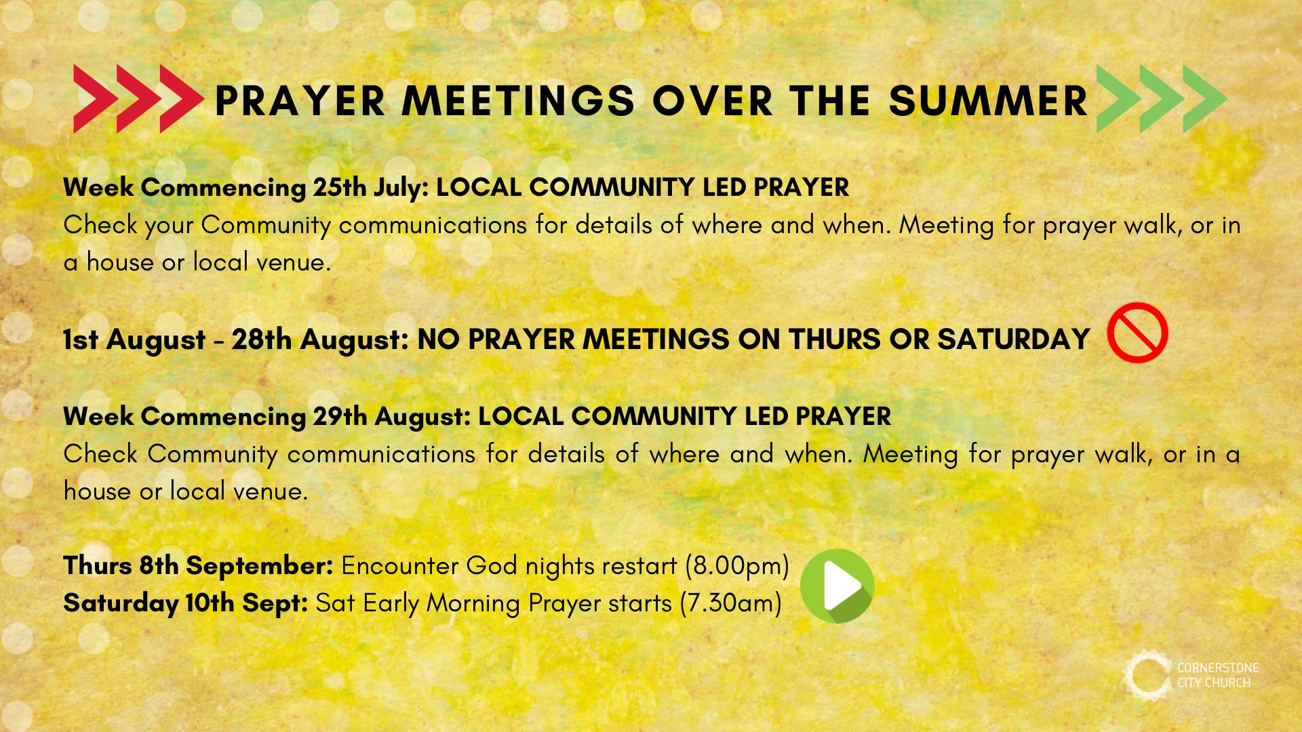

Slide 35


Slide 36


Slide 37
Believe For It
CCLI Song # 7169164
CeCe Winans | Dwan Hill | Kyle Lee | Mitch Wong
© 2021 Fair Trade Tunes (Admin. by / Small Stone Media BV, Holland (Admin. in the UK/Eire by Song Solutions www.songsolutions.org))
From The Void (Admin. by / Small Stone Media BV, Holland (Admin. in the UK/Eire by Song Solutions www.songsolutions.org))
A Wong Made Write Publishing (Admin. by Integrity Music Ltd)
Integrity's Praise! Music (Admin. by Integrity Music Ltd)
Big Buddy Music (Admin. by Song Solutions www.songsolutions.org)
Little Pooky's Music (Admin. by Song Solutions www.songsolutions.org)
For use solely with the SongSelect® Terms of Use. All rights reserved. www.ccli.com
CCLI Licence No. 33265

Slide 38
1/6
They say this mountain can't be moved
They say these chains will never break
But they don't know You like we do
There is power in Your name

Slide 39
2/6
We've heard that there is no way through
We've heard the tide will never change
They haven't seen what You can do
There is power in Your name
So much power in Your name

Slide 40
3/6
Move the immovable
Break the unbreakable
God we believe
God we believe for it
From the impossible
We'll see a miracle
God we believe
God we believe for it

Slide 41
4/6
We know that hope is never lost
Oh for there is still an empty grave
God we believe no matter what
There is power in Your name
So much power in Your name

Slide 42
5/6
You are the way when there seems to be no way
We trust in You God You have the final say

Slide 43
6/6
You said it
I believe it
You said it
It is done

Slide 44
Firm Foundation (He Won't)
CCLI Song # 7188203
Austin Davis | Chandler Moore | Cody Carnes
© 2021 For Humans Publishing (Admin by Essential Music Publishing)
Maverick City Publishing (Admin by Essential Music Publishing)
Capitol CMG Paragon (Admin. by Capitol CMG Publishing)
TBCO Publishing (Admin. by Capitol CMG Publishing)
Writer's Roof Publishing (Admin. by Capitol CMG Publishing)
A.L.K.D. Music (Admin. by Watershed Music Group (Admin. by Capitol CMG Publishing))
For use solely with the SongSelect® Terms of Use. All rights reserved. www.ccli.com
CCLI Licence No. 33265

Slide 45
1/5
Christ is my firm foundation
The rock on which I stand
When everything around me is shaken
I've never been more glad
That I put my faith in Jesus
'Cause He's never let me down
He's faithful through generations
So why would He fail now

Slide 46
2/5
He won’t
He won't

Slide 47
3/5
I've still got joy in chaos
I've got peace that makes no sense
So I won't be going under
I'm not held by my own strength
'Cause I've built my life on Jesus
He's never let me down
He's faithful in every season
So why would He fail now

Slide 48
4/5
He won’t He won't
He won't fail
He won't fail

Slide 49
5/5
Rain came and wind blew
My house was built on You
I'm safe with You
I'm going to make it through

